Slide 1
The Delicate Balance Between In-Person and Online Learning in a Hybrid JD Program
University of Denver Sturm College of Law ~ Online & Hybrid Learning Conference ~ September 27, 2024
The Colleges of Law
Dean Andrea Funk
Associate Dean Brandy Price

Slide 2
Asynchronous, Synchronous, In Person…Oh My…
Notes:
1.Briefly present the pros and cons of each teaching modality (3 minutes)
Asynchronous (activities allow students to flexibly engage with the material)
Synchronous live online (activities are ideal for collaborative learning and discussions that require immediate input)
Synchronous live in-person (sessions are best for complex, interactive activities that benefit from direct engagement and immediate support)

Slide 3
Specific Examples
Teaching Content
Providing Feedback
Community Building
Other Educational or Professional Goals
Notes:
3. Use specific examples to demonstrate which modality works best for (8 minutes): Teaching, Feedback, Community Building, Other Educational or Professional Goals

Slide 4
Teaching Content
More Efficient Delivery
ASYNCHRONOUS
A Flipped Classroom
Lecture Videos
Reading Assignments
Canvas Discussions
Formative Assessments

Slide 5
Providing Feedback
But…
or
And…
ASYNCHRONOUS
Confirm Understanding
Global Feedback/Model or Sample Answer/Key – Written or Video
Video Review Session
Individual Feedback – Written or Video
Notes:
But or and : synchronous online or in person also works

Slide 6
Community Building
But…
or
And…
IN PERSON
Cohort Engagement
Orientation
Community Events
Residencies
Notes:
But or and : synchronous online could work as well (example, during pandemic)

Slide 7
Other Educational or Professional Goals
IN PERSON
OR
SYNCHRONOUS ONLINE
Professional Development
Moot Court
Simulations
Trial Advocacy
Skill-building Sessions

Slide 8
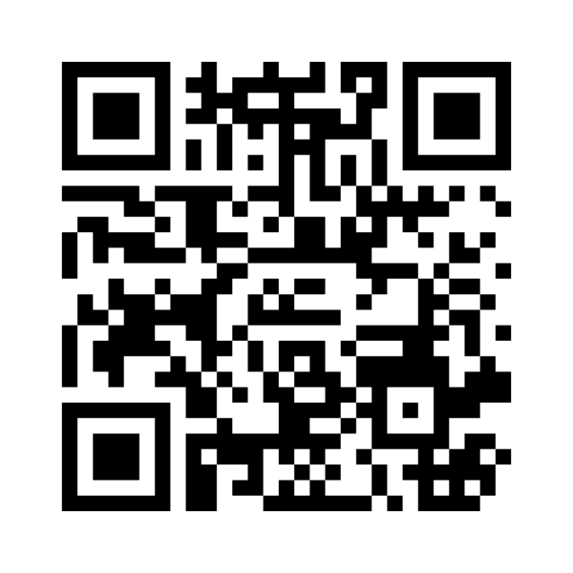
Mentimeter
Mentimeter.com 5175 3339
Notes:
2. Engage the audience in an interactive exercise using technology to allow them to both participate in the presentation and foster discussion (12 minutes)
Poll everywhere:
4 choices – Asynchronous; Synchronous (online); Synchronous (in-person); All
Introductions
Lectures Addressing Complex Content
Office Hours
Academic Advising
Student Mentors (interfacing with)
Review Sessions
Polling (expand category?)
Group Discussions
Debates (?)
Presentations
Small Group Breakouts
Group Projects
Final Exams (if asynch/synch online, use proctors)

Slide 9
Faculty and Student Experience: Their Feedback
Faculty
Students
Host synchronous online office hours (either weekly or bi-weekly).
Offer additional synchronous online sessions between live residencies.
Offer synchronous online final exam review sessions.
Want more live opportunities to connect with professors.
Notes:
4. Share feedback from both the faculty and student experience that has impacted and influenced course instructional design and allocation of resources (4 minutes)
Faculty
Host synchronous online office hours (either weekly or bi-weekly)
Offer additional synchronous online sessions between live residencies
Offer synchronous online final exam review sessions
Students
Want more live opportunities to connect with professors

Slide 10
Administrative Experience: Key Takeaways
Notes:
5. Provide key takeaways from program administrators about how to strike the right balance between in-person and online learning (3 minutes)
Administrative
High touch
Admissions
Interview
Program Manager/Student Services Coordinator
Rotating Sessions
Support
Professors
Canvas shell with resources
Associate Dean of Student Success
Canvas shell with resources
Academic success workshops
There is NO one way or one right way
Consider YOUR program, YOUR school, and YOUR students:
what is working, what is not, where can student learning be improved?

Slide 11
Notes:
6. Allow time for questions and answers (5 minutes)

Slide 12
Thank you! To balance!

