Slide 1

Lessons from the Trailblazers: Bar Passage Data and Analysis from the Nation’s First Hybrid JD Program

Slide 2

Blended Program Structure & Development
January 2015: Mitchell Hamline is first ABA-approved law school in the nation to offer J.D. using blended education
Part-time, four-year, partial cohort model
Asynchronous online + intensive on-campus prep and capstone weeks
Cross-course integration
Academic and administrative support for each section
Faculty-led course design, in-house instructional designers

Slide 3
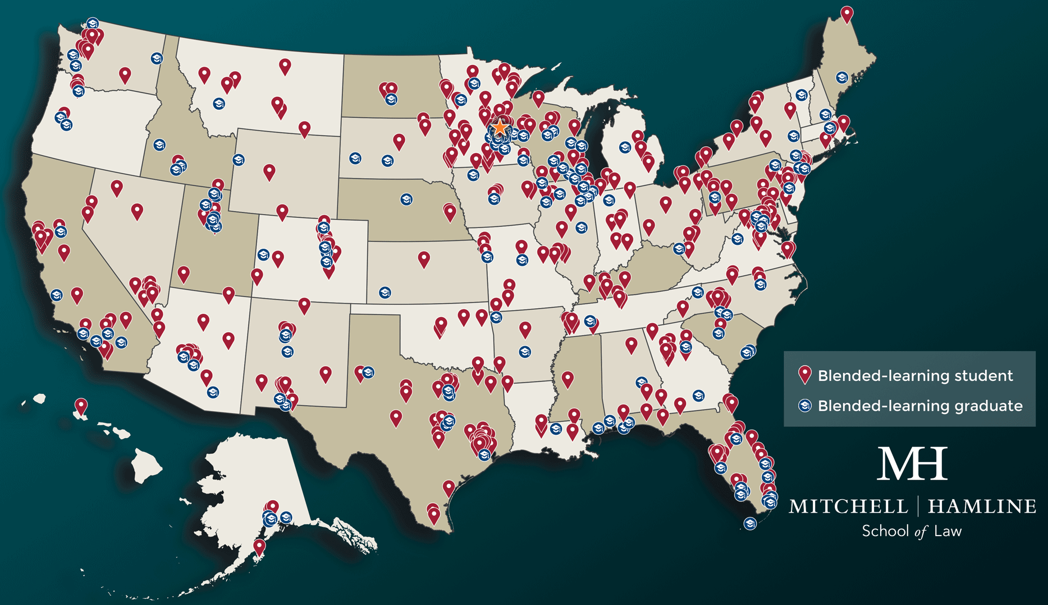
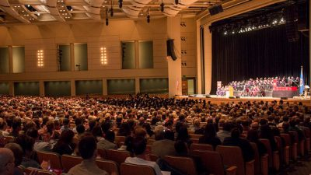
Successes in Blended Program
2018:
First cohort of blended
bar-takers
July 2023:
Highest blended
bar passage ever

Slide 4
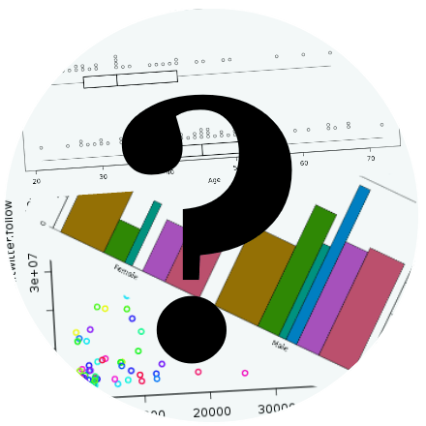
Bar Data Challenges
Collection
Analysis
Interpretation
Action
ThePhoto by PhotoAuthor is licensed under CCYYSA.

Slide 5
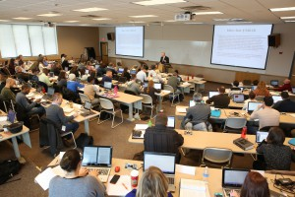
Changes: All Modalities
Mandatory bar-like assessments in bar courses
Required bar courses for students with lower GPAs
Structured tutoring for students on academic probation

Slide 6
Changes: Blended-Specific
Emphasis on summative assessments
Application focus during
on-campus capstones
Earlier and more frequent bar "messaging"
Academic & bar-support
Course-by-course
Areas we're still exploring

Slide 7

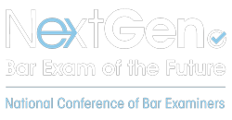
NextGen Bar Exam
How do we prepare for the NextGen in our Blended program?
ThePhoto by PhotoAuthor is licensed under CCYYSA.

Slide 8
Takeaways & Questions

