Slide 1
Balancing Act: Maximizing the Benefits of In-Person Components of Legal Education
Third Online & Hybrid Pedagogy Conference September 27, 2024

Slide 2
Presenters
Gary Craig, Clinical Professor of Law
14 years teaching in law school
Former Associate Dean, including during Hybrid JD Program launch
Aimee Dudovitz, Associate Dean for Strategic Initiatives and Clinical Professor of Law
14 years teaching in law school
Associate Dean, including during Hybrid JD program launch; teaching in the program this spring

Slide 3
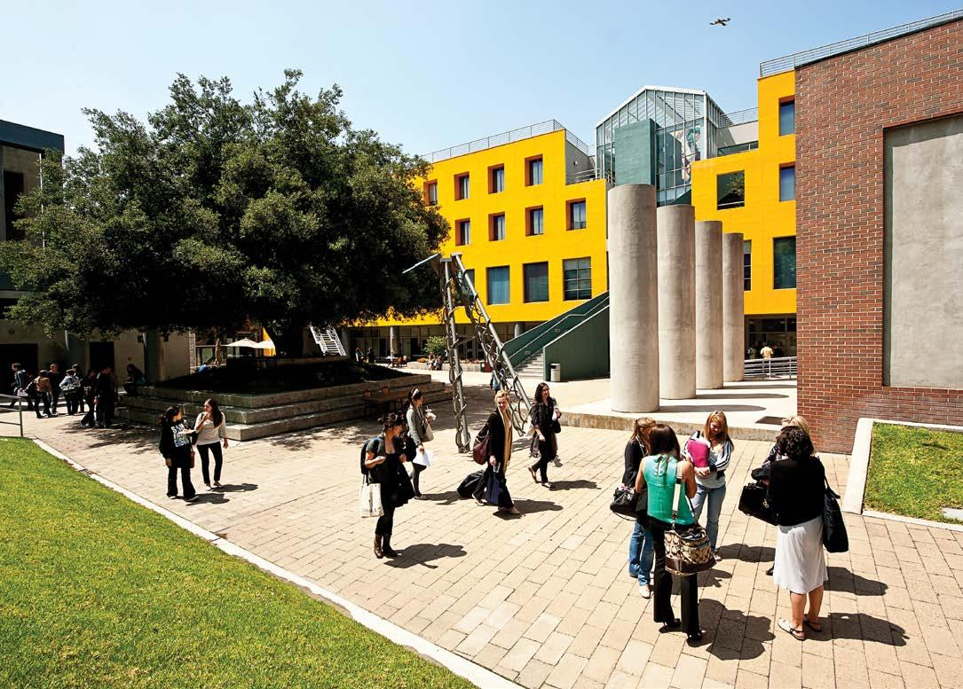
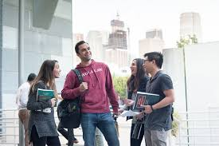
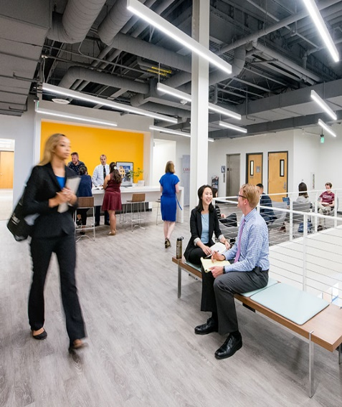
Topic for Discussion
What are the benefits of providing an in-person component to the legal education experience?

Slide 4
Four Potential Benefits of In-Person Components of Legal Education
Community
Multimodal teaching and learning
Preparing for in-person aspects of law practice
Serendipity

Slide 5
Enhancing Community and Connectedness

Slide 6
Multimodal Learning
Do you think there is a benefit for students to have an opportunity to learn with both remote and in-person modalities?
Why or why not?

Slide 7
Multimodal Practice
To the extent there are in-person aspects of law practice in your city/state, do you think it is beneficial to students to learn about those aspects by being in person?
Why or why not?

Slide 8
Serendipity
“The occurrence and development of events by chance in a happy or beneficial way.”
Oxford Dictionary

Slide 9
Serendipity (cont.)
Have you ever considered the benefit of serendipity in legal education?
How have you seen serendipity manifest in law school?
How do you create space for serendipity remotely?

Slide 10
Questions for Discussion
Are there other benefits of providing an in-person component to the legal education experience?
For the various potential benefits of in-person aspects of legal education we have discussed, how have your schools attempted to replicate the in-person components remotely?

Slide 11
Questions

