Slide 1
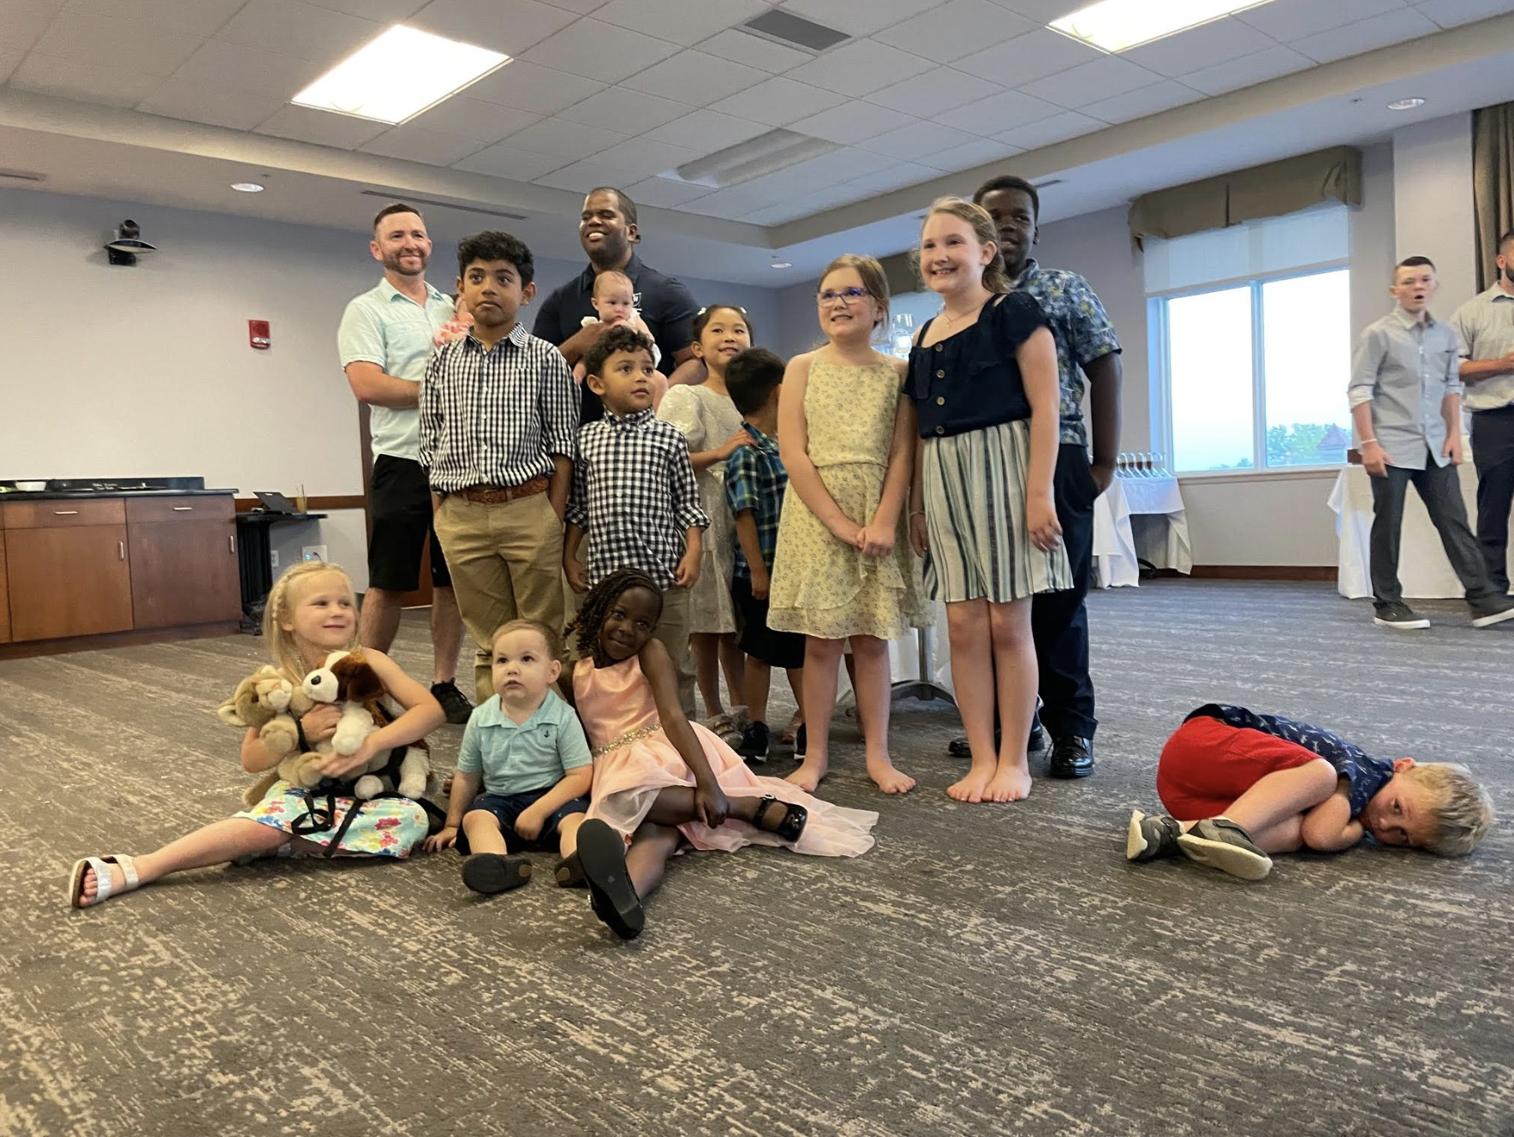
Residential Components of Online Learning
New Ways to Think About Design and Assessment
Megan Carpenter, Dean and Professor of Law
©2023 UNH Franklin Pierce School of Law. All Rights Reserved.

Slide 2
The legal profession and mental health
66% of lawyers say time in legal profession has been detrimental to their mental health
46% of lawyers say they are considering leaving legal profession due to stress or burnout
From Journal of Addiction Medicine (survey of over 12K lawyers)
Anxiety: 61.1%
Depression: 45.7%
Attention deficit hyperactivity disorder (ADHD): 12.5%
Panic disorder: 8.0%
Suicidal thoughts: 11.5%

Slide 3
Law students and mental health
40% of law students are depressed after 3 years
96% of law students face significant stress (compared to 70% of med students and 43% of grad students)
42% of law students in a 2016 study felt they needed mental health counseling, but only half sought it out
Nearly 26.8% of law students in a 2021 study were at risk for alcoholism
11% of law students reported suicidal thoughts in the prior year
20-40% of law students report psychological dysfunction after law school

Slide 4
Connectivity is not connection
Surgeon General: epidemic of isolation and loneliness
Technology is designed for end user, single person (different profit goals)
Tech platforms are designed to satisfy selfish and individual, temporary needs. Big problem with digital worlds we inhabit.
Extensive technology use, including smartphone dependency, use of social media, and high internet use leads to depression, anxiety, and loneliness.

Slide 5
In other words, digital environments that we use for commerce, socializing are growing a bit cold. What’s the other side of that?

Slide 6
Warmth is a principle of connection. “Through interpersonal warmth, a sense of interconnectedness becomes more tangible and accessible.” Pema Chödrön

Slide 7
Warmth and connection have significant positive impacts on health and wellness (and ability to learn).
Supports perception of value, competence
Strengthens self-worth
Supports tendencies toward reciprocation and justice
Realizes compassion and gratitude
Reduces stress, anxiety, depression, blood pressure, heart disease

Slide 8
Components of warmth and connection
1. Respectful conversation
2. Scaffolding to self-actualization
3. Belonging to something bigger than yourself

Slide 9
Provocations
How might we make the residential experience of hybrid and online education centered on respectful conversation?
2. How might we construct a scaffolding for self-actualization?
3. How might we connect the students to something larger, with a sense of belonging and purpose?
And: How might we try and develop these connections through digital platforms, as well?

Slide 10
As we build hybrid and online education on these platforms, we must do so in a way that promotes connection. I propose that we are more successful as educators if we can measure ourselves by standards of warmth.

Slide 11
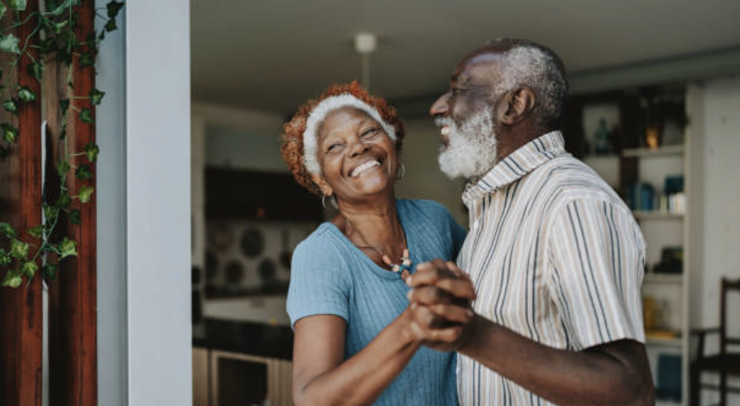
1. Respectful conversation
- method: How do we design respectful conversation into the process for delivery? How are you bringing people to the table as co-creators?
- result: Does that product have channels to support that conversation on an ongoing basis? Ability to continue that conversation? Stakeholders when that experience is over should still be involved, should still have a voice.

Slide 12
Examples of design of residential immersions through respectful conversation
Method:
Orientation speech
Residential components materially different (practical, experiential)
More residential opportunities, on location
Result:
Engaging alumni in immersions (including recent)
Barn 3.0
Strategic planning
Alumni teaching on location, receptions

Slide 13
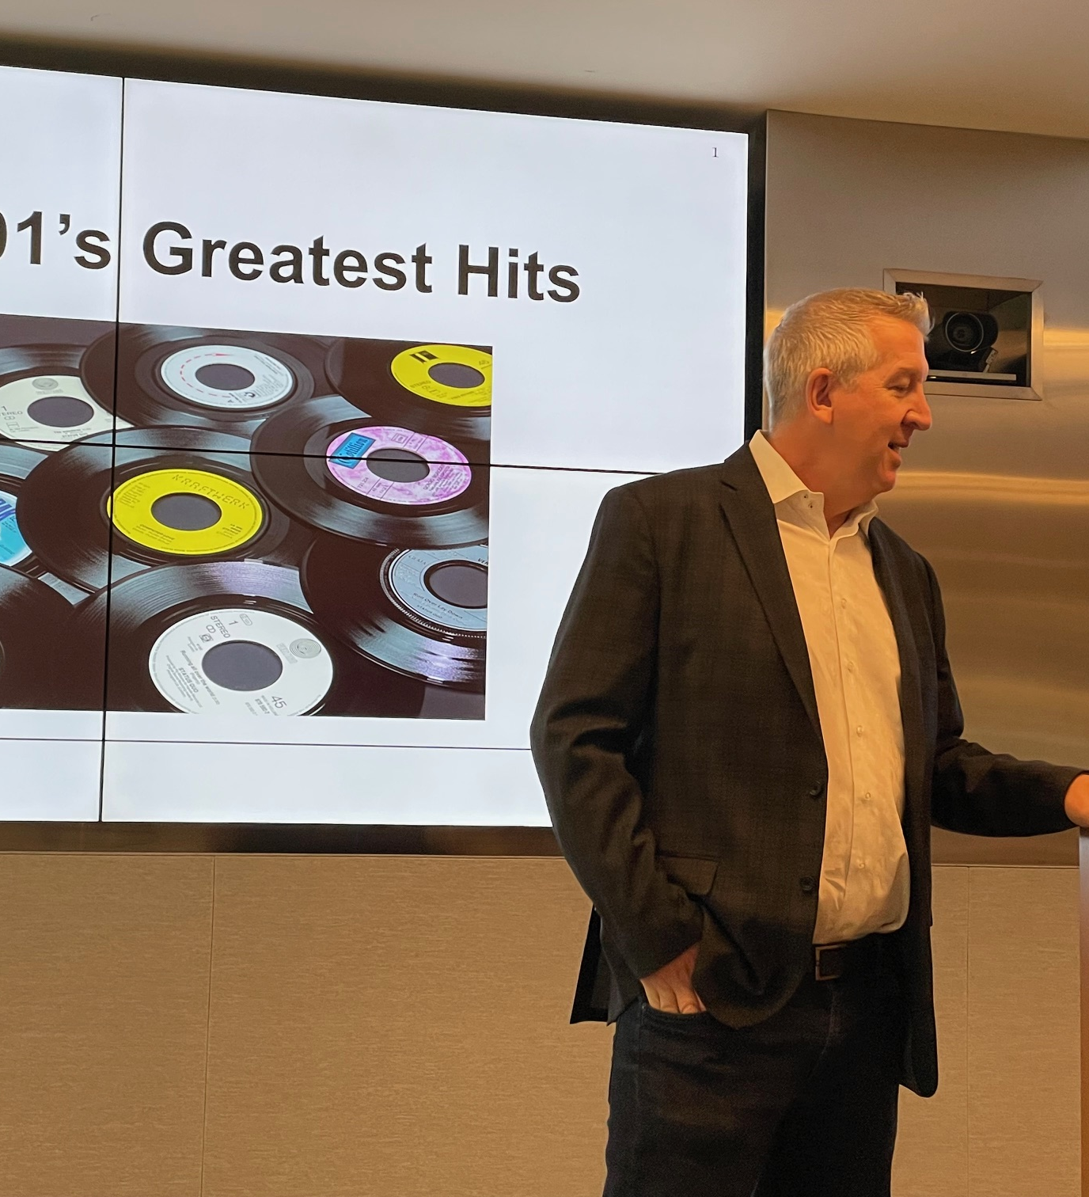
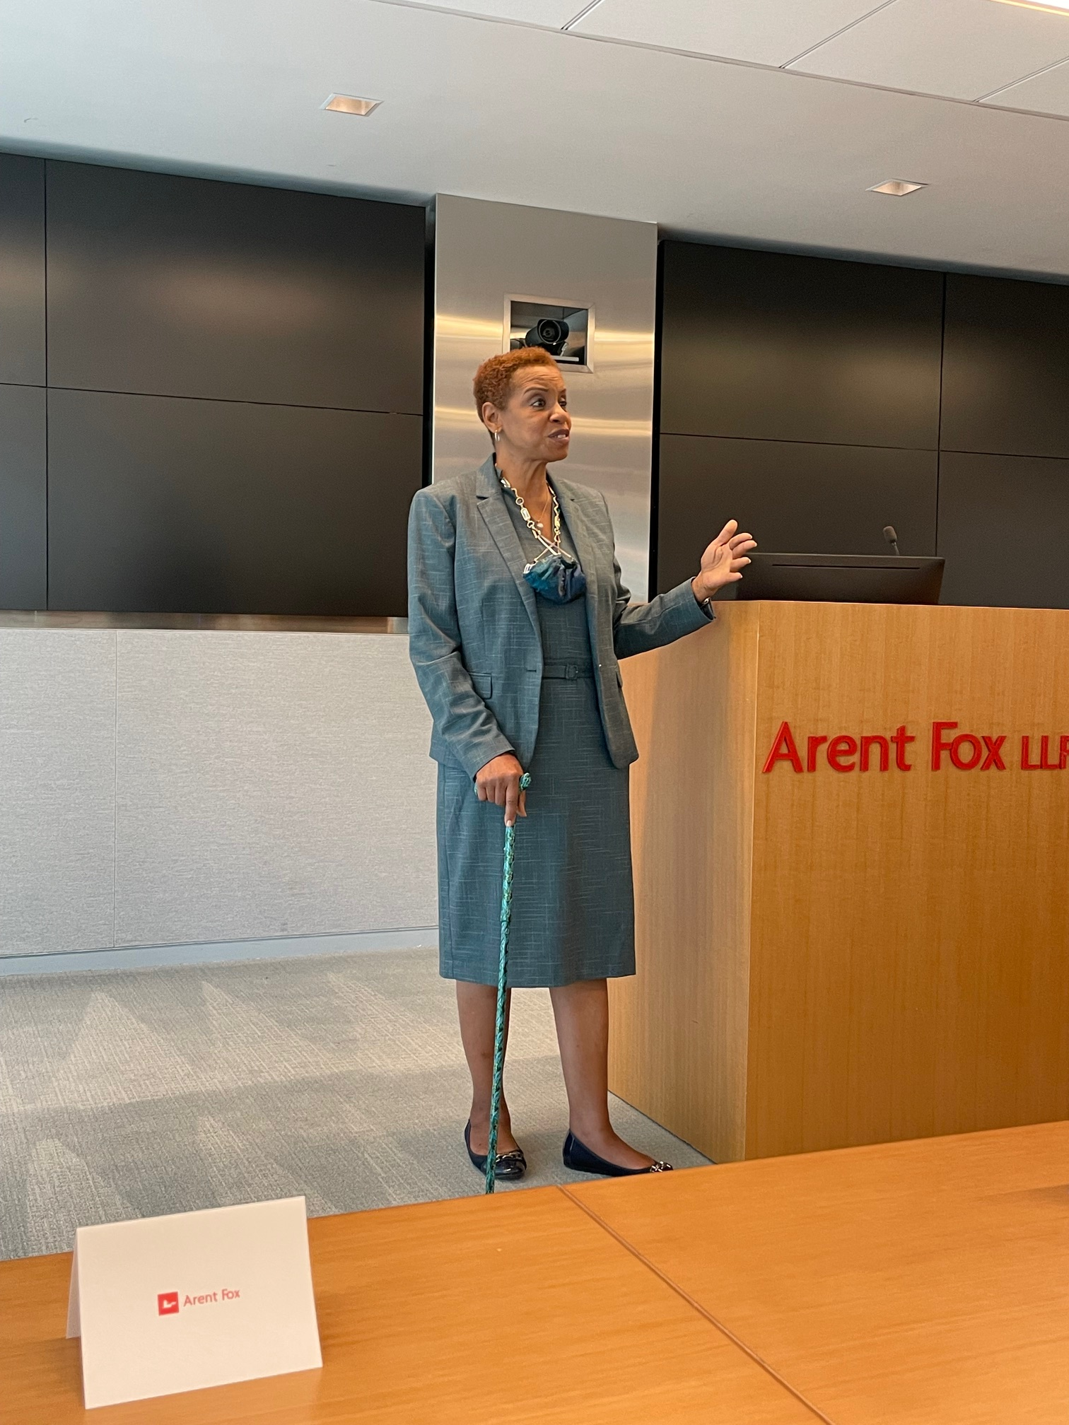
Alumni teaching in context, on location

Slide 14
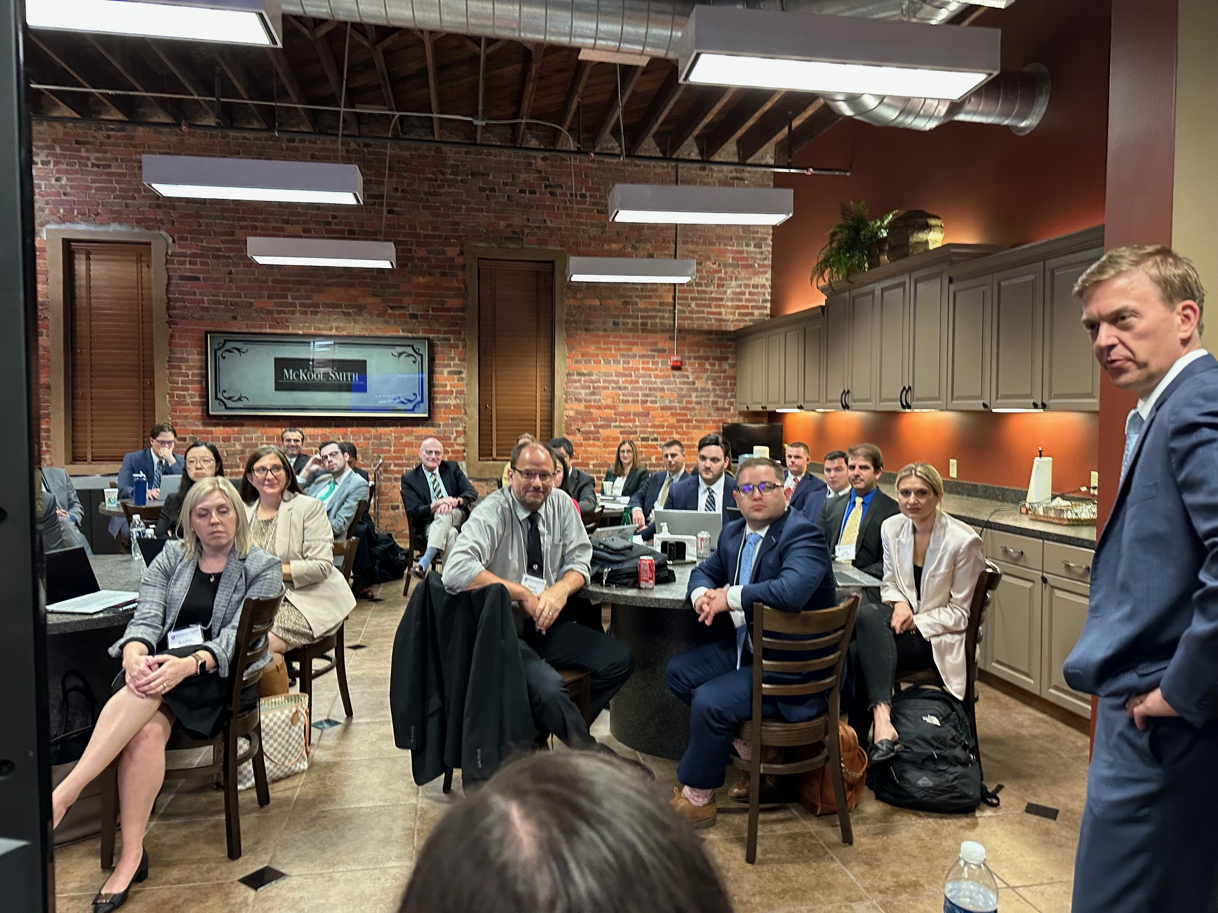
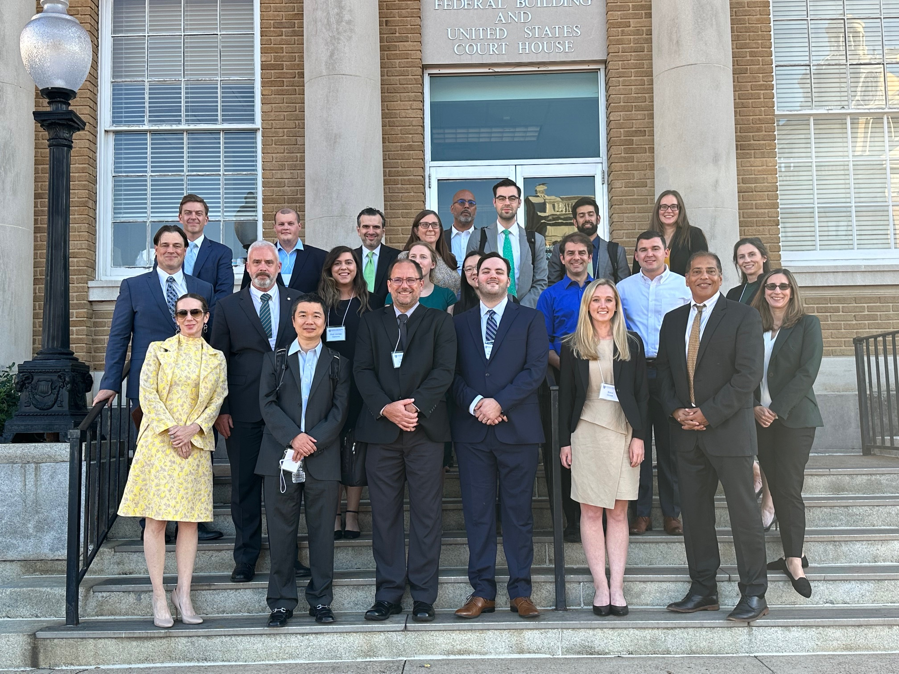

Slide 15
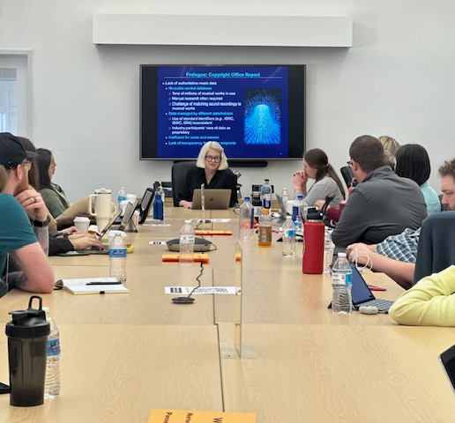
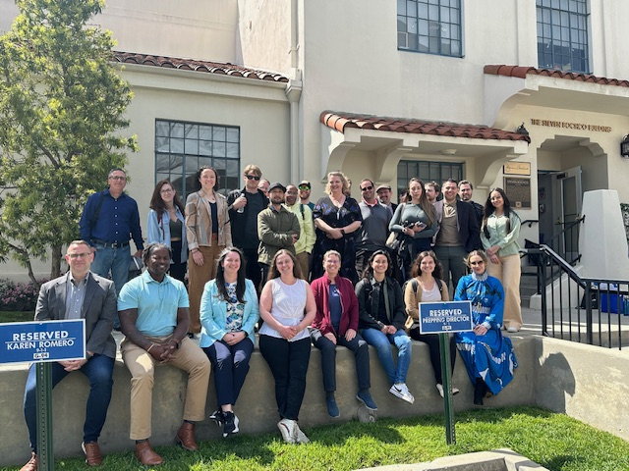
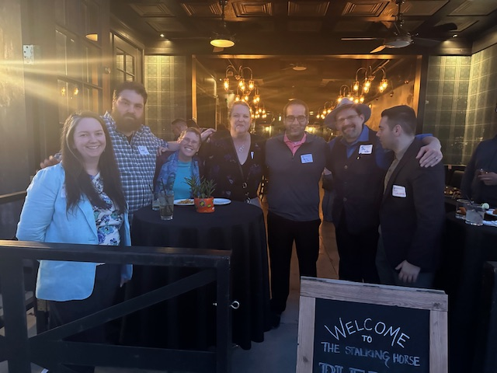

Slide 16
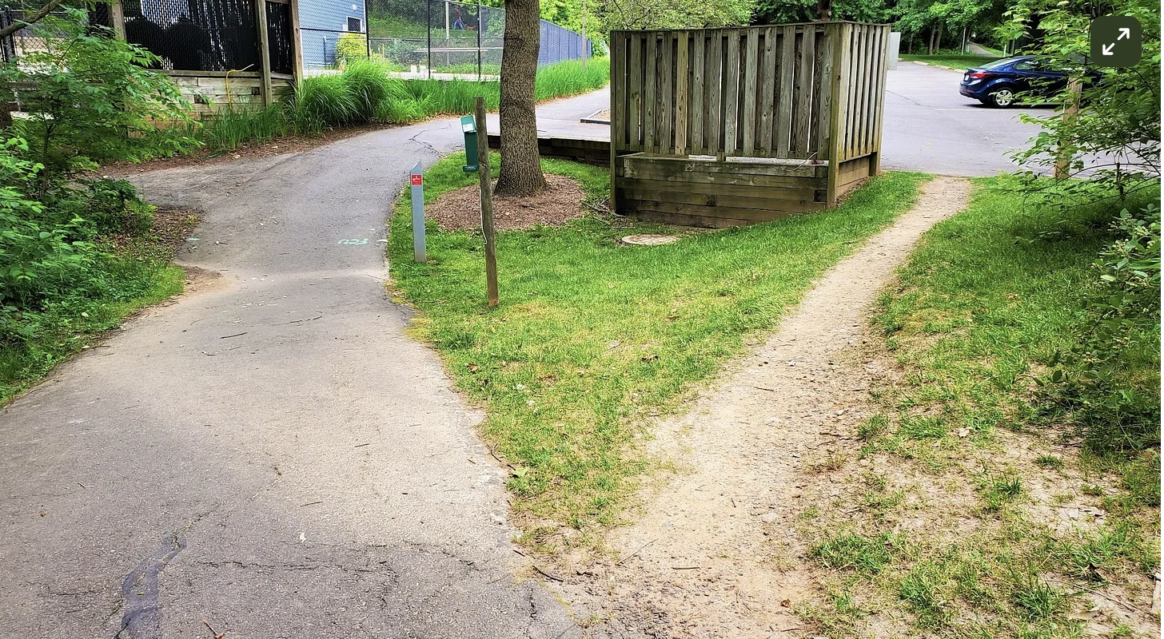
2. Scaffolding for self-actualization
Essential that they come into the program feeling like their unique experience is valued, and they will then be more likely to help neighbors, to feel cohesion and unity, perceive importance in that community.
Individual’s unique experience is respected in the shared experience and leveraged for the benefit of the whole. It’s not, “come and act like lawyers.” It’s “come and bring your unique experience to bear on this education.”
Nudging
Freedom and irrationality

Slide 17
Examples of scaffolding for self-actualization in residential immersions
Engage previous work experience
Orientation
Increasing number of immersions, locations of immersions
Scavenger hunt, first residential immersion, solving clues
Immersions away we engage them with alumni, develop professional networks. (Esp helpful for diversity and inclusion)
Leave negative space for activities that are location-based and community building, let students lead.
Office hours are often like a “coffee clatch”

Slide 18
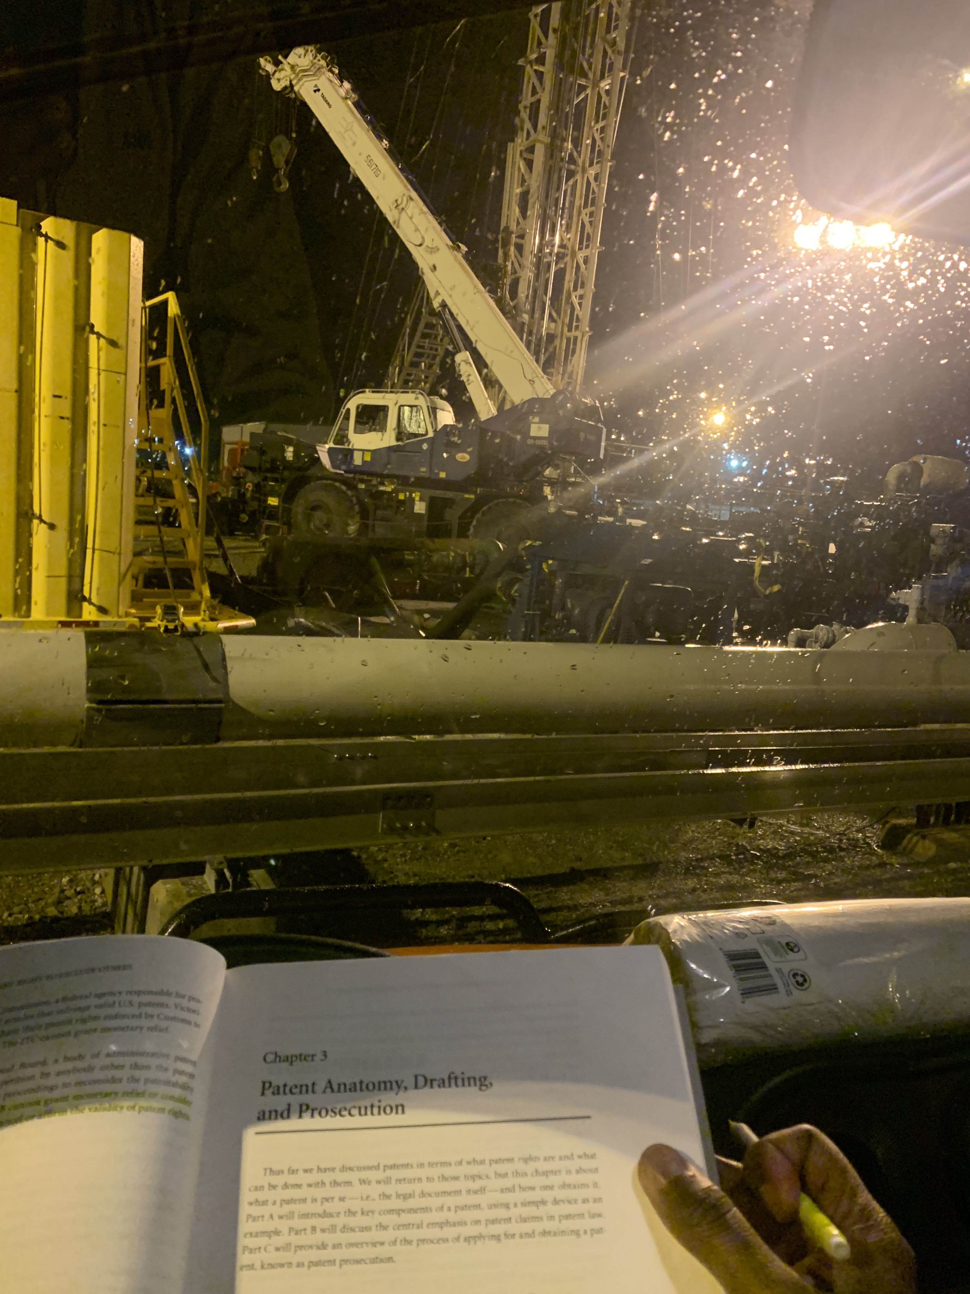
Bring your whole self

Slide 19
Bring your whole sel(ves)

Slide 20
“For the momma group”

Slide 21
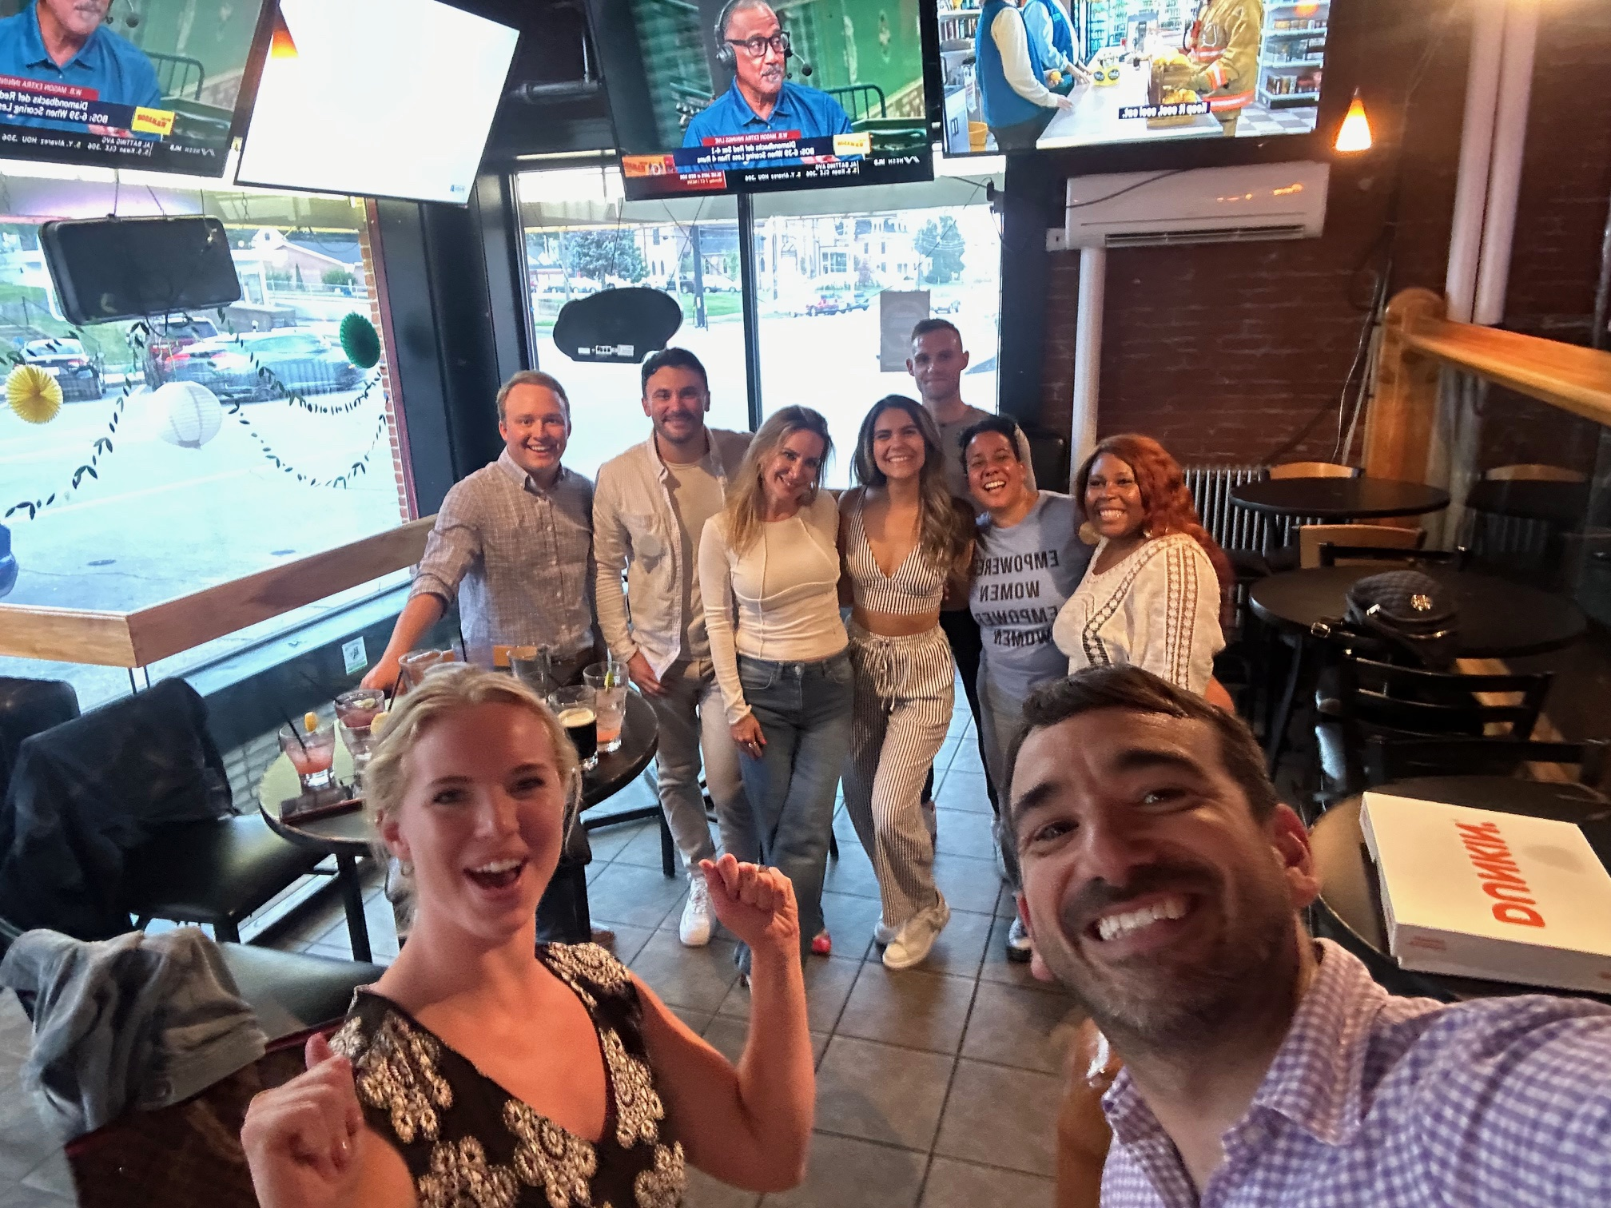
3. Belonging to something bigger
Purpose
Size and shape of community
Knowing the source
Operational transparency
Knowing who to thank
Opportunities for reciprocation

Slide 22
Examples of purpose and belonging in residential immersions.
“Be what drives innovation.”
Immersions connect to alumni doing this work, connect learning from classrooms to leaders in field wrestling with largest questions (MS and OpenAI, head of Google IP antitrust, Texas courtroom)
Collaborations: Partnered with another law school in Hawaii, focused on social justice. 20 of our students coming with IP experience, 20 with social justice, indigenous/human rights.
Operational transparency (never enough)
Orientation – The Bird
Barn 3.0

Slide 23
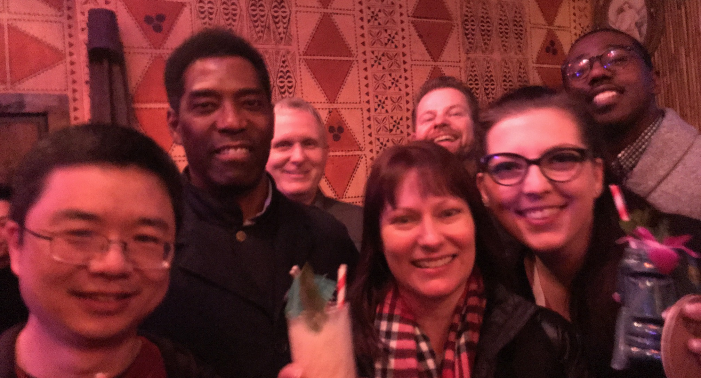
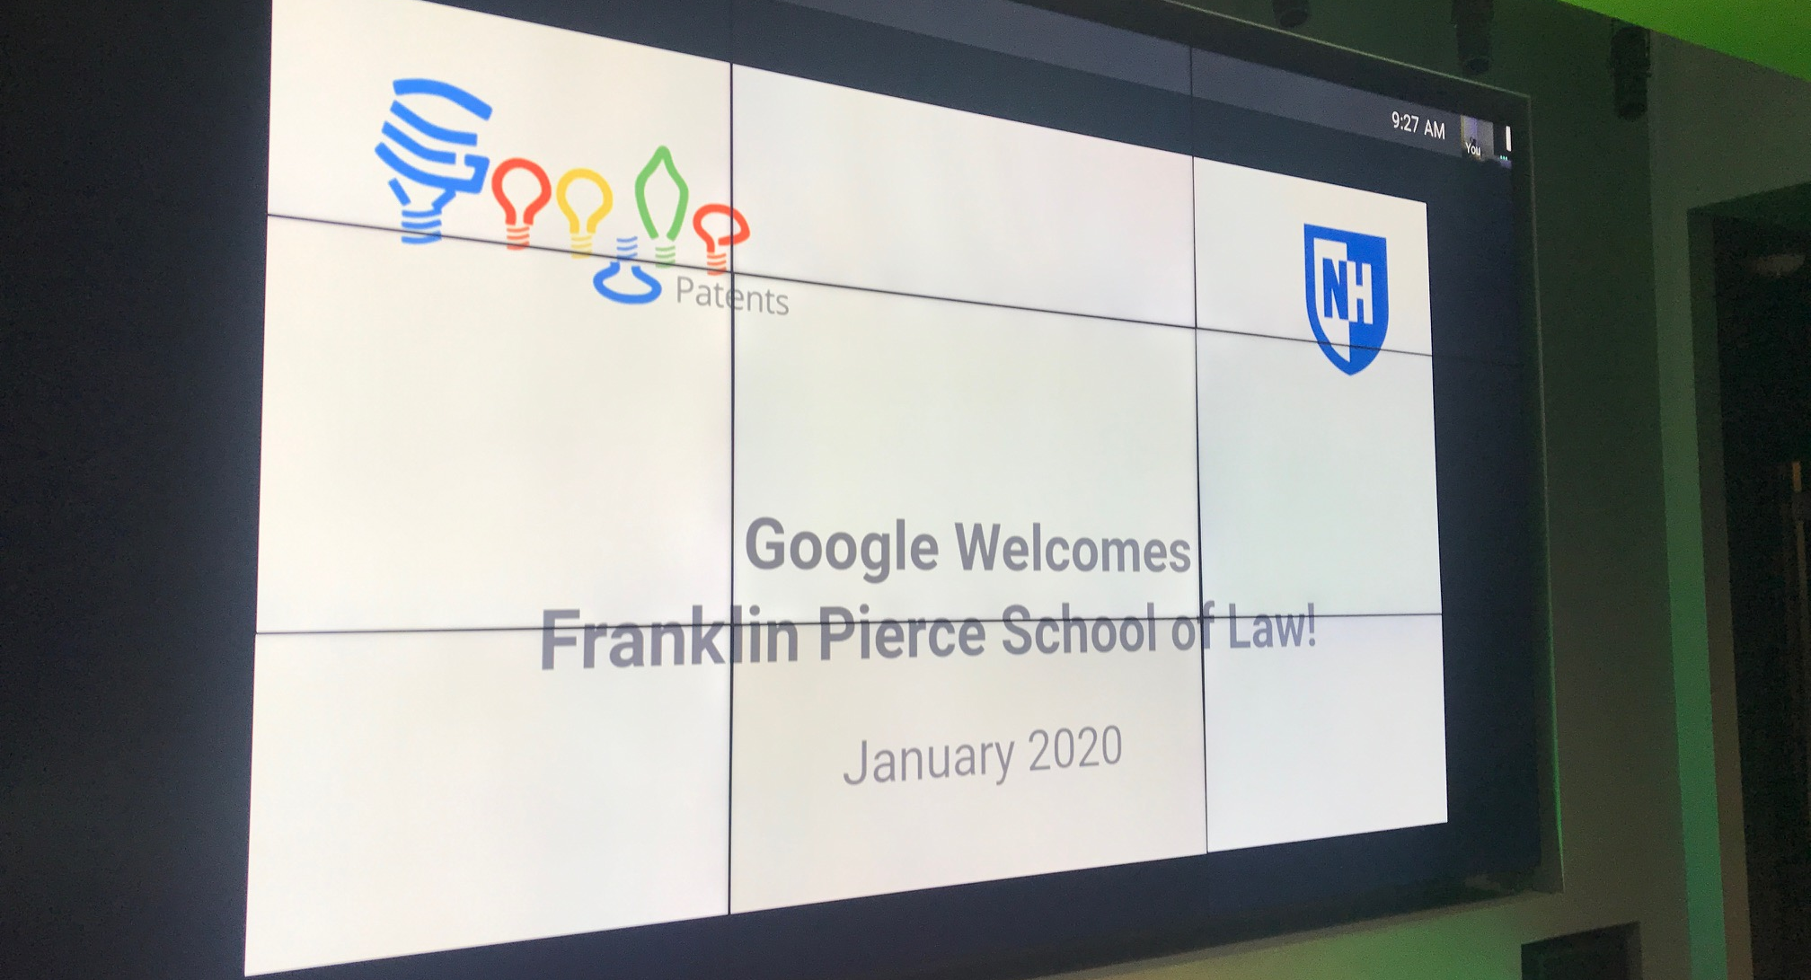
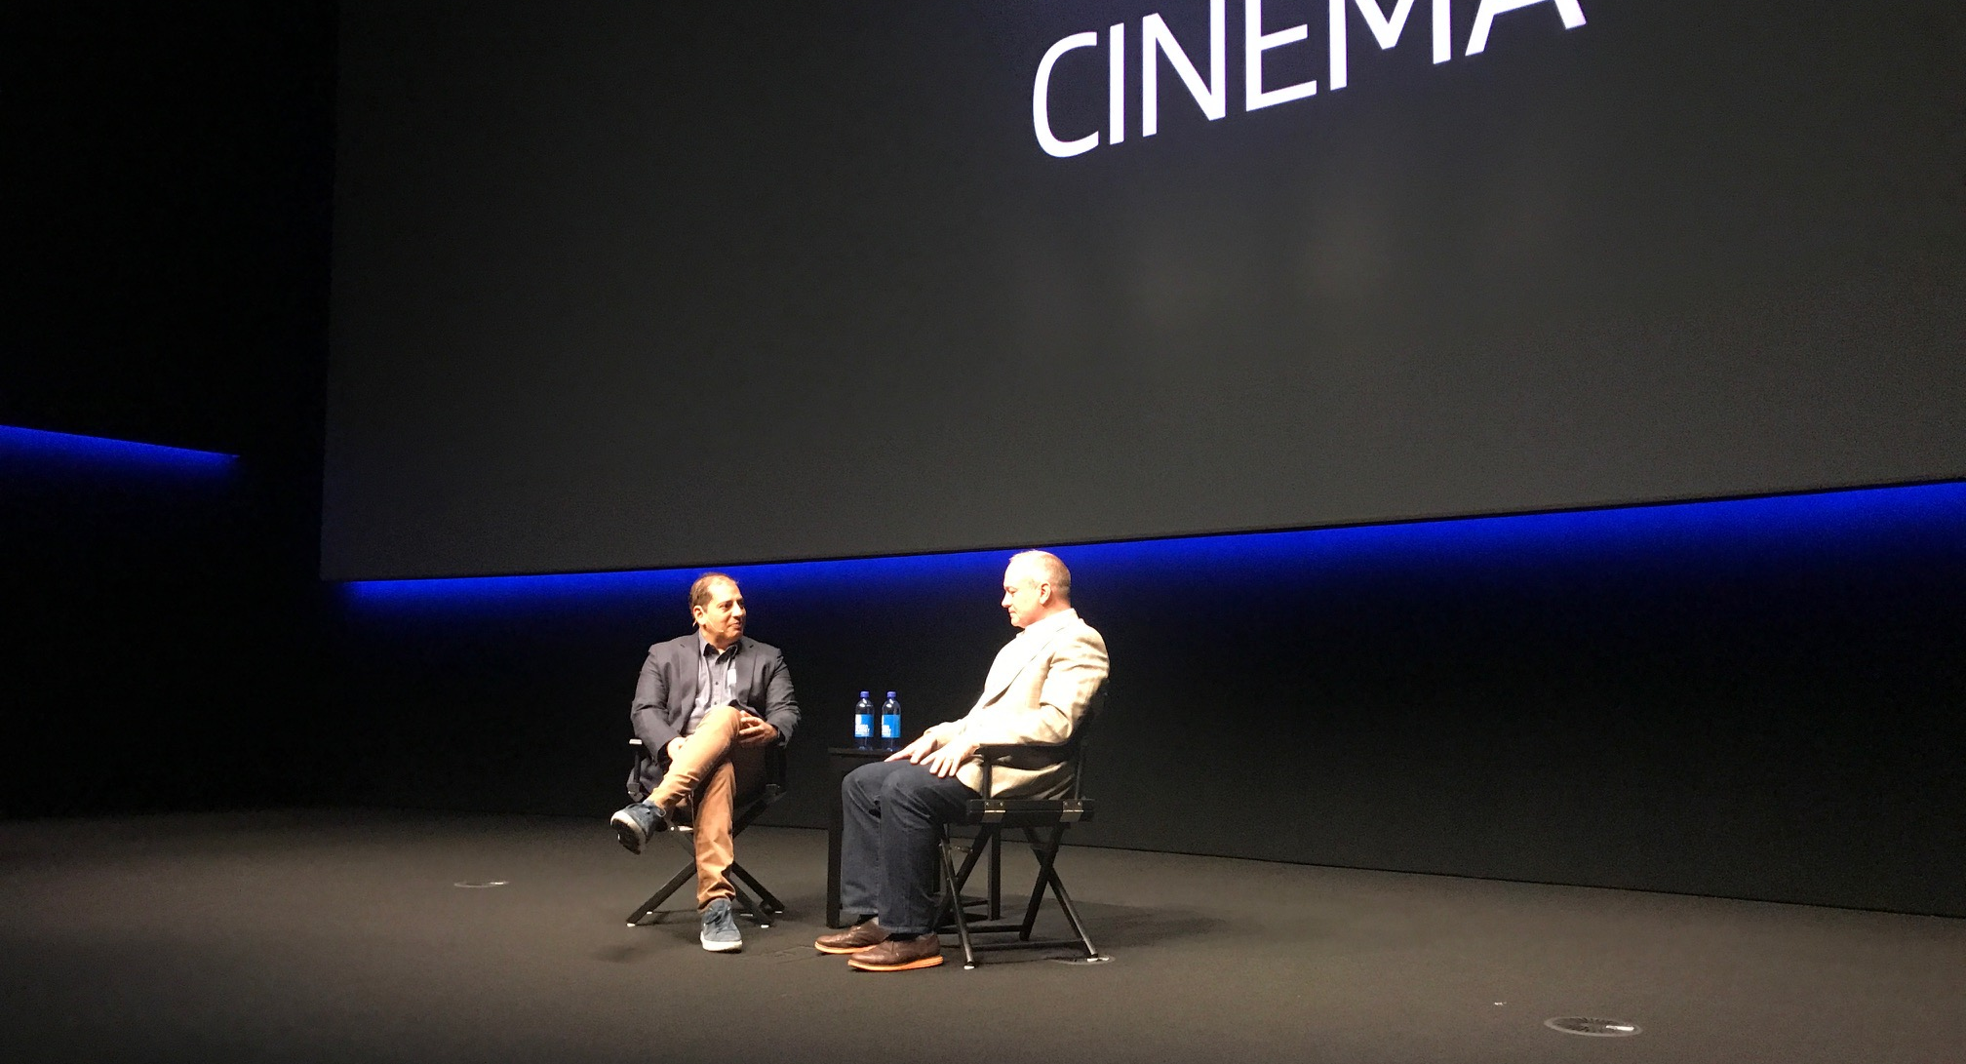
What is our purpose?

Slide 24
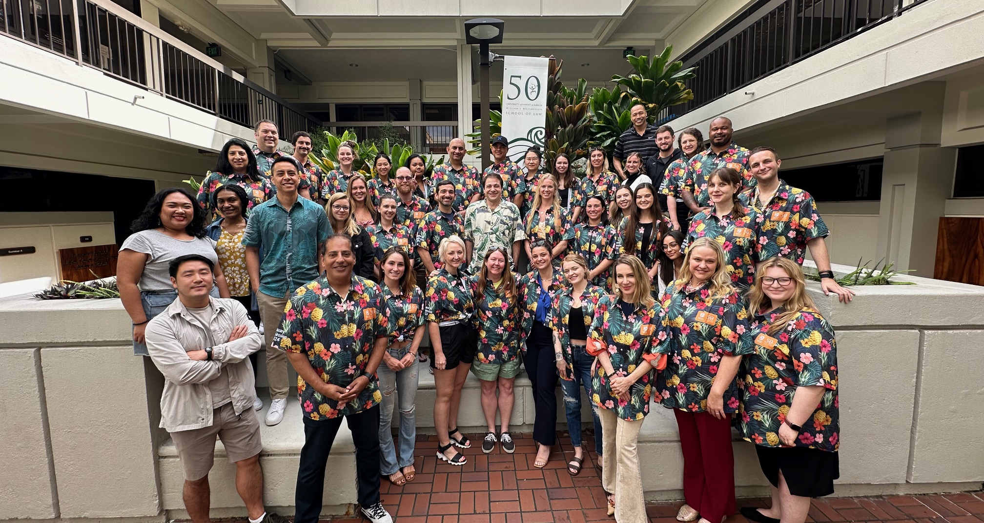
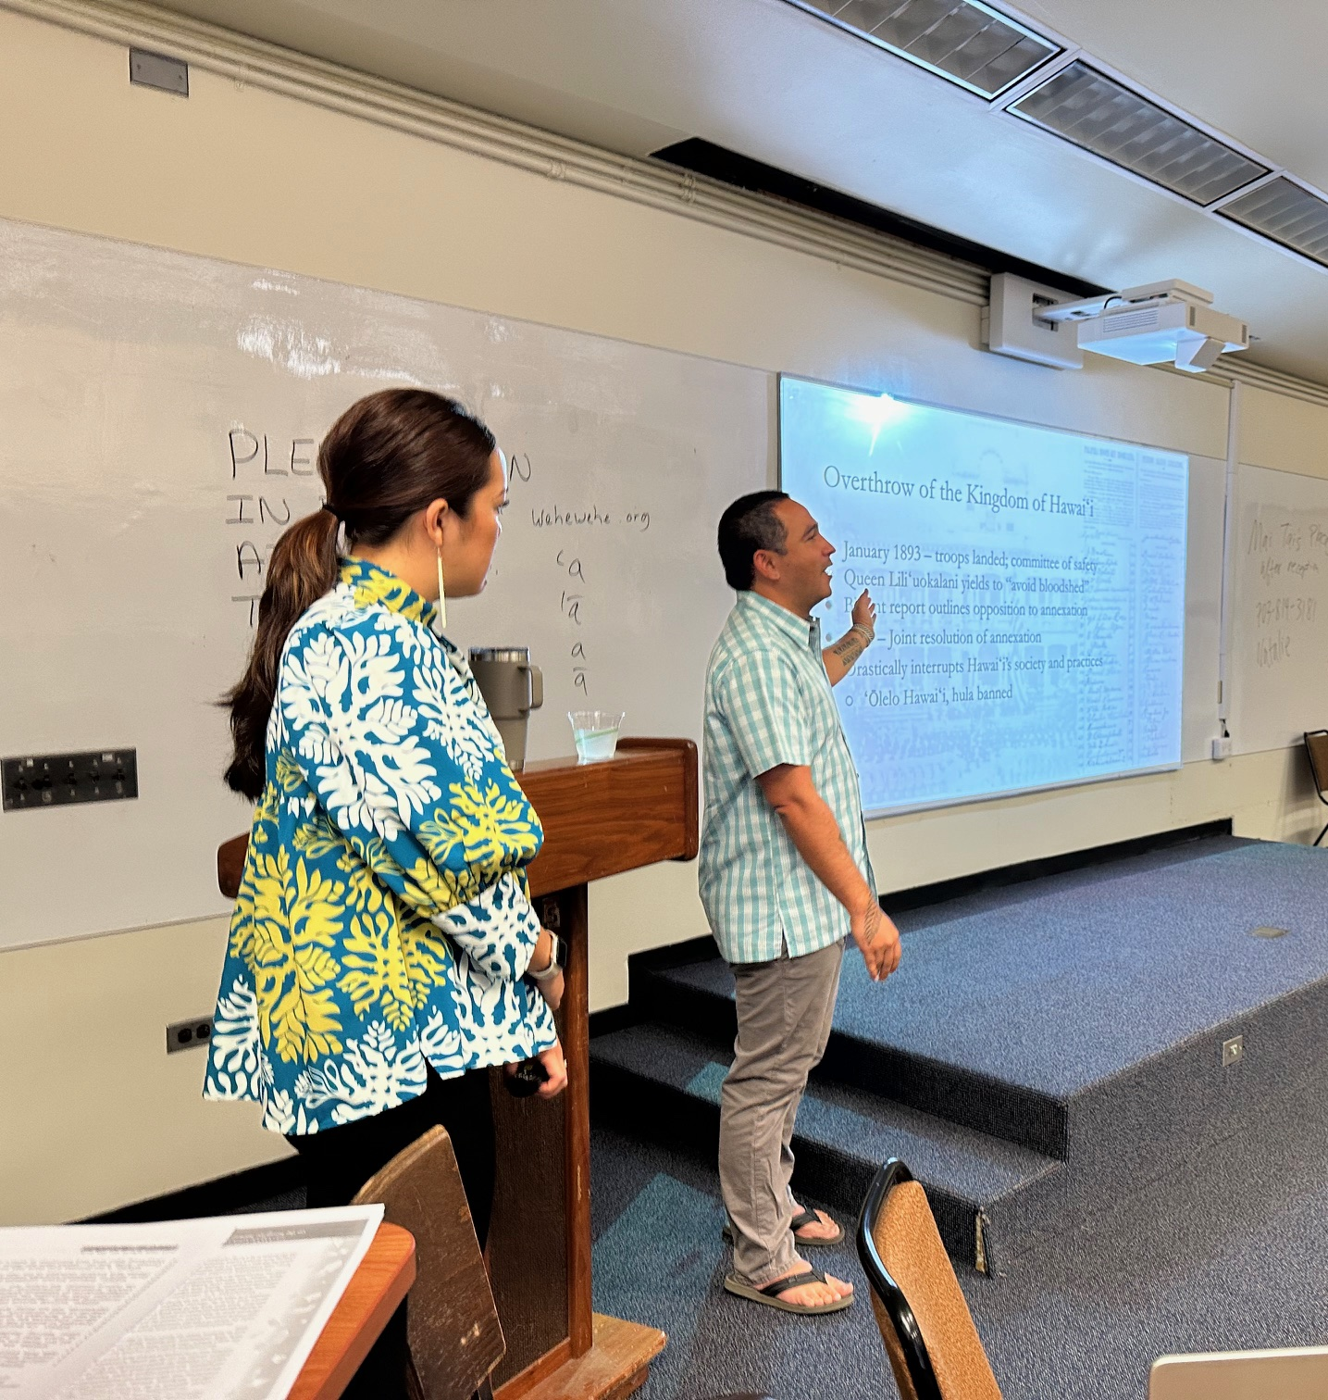
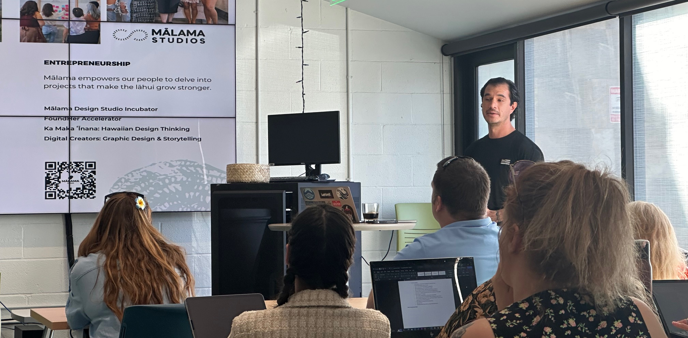

Slide 25
Reciprocity: Barn 3.0

Slide 26
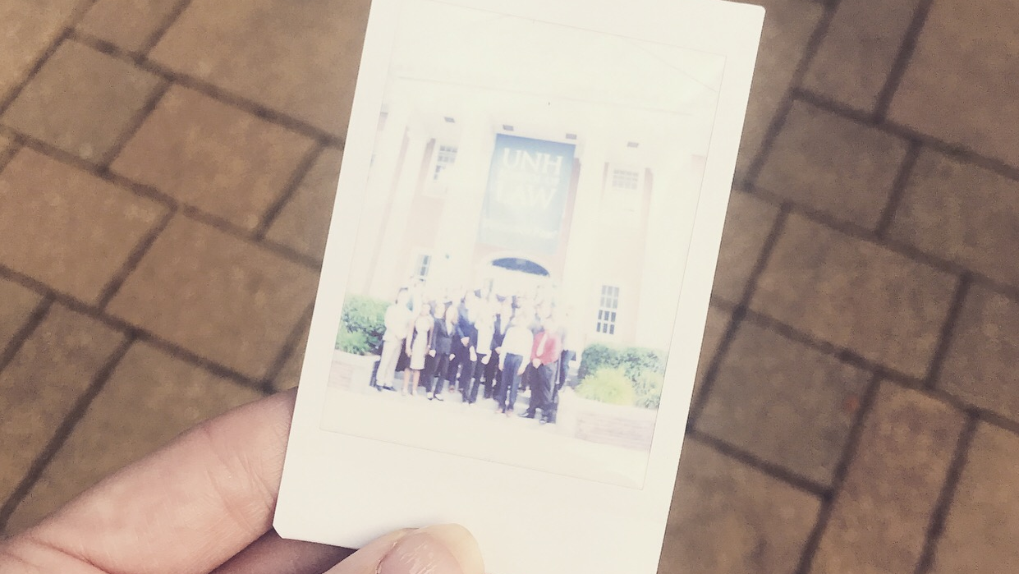

Slide 28
Fast forward to the present
“I am so proud of everything that has been going on at the law school over the past year, and our plans for the future, and I can’t wait to share it with you.”
Megan Carpenter
Dean and Professor of Law
Thank You.
Inaugural Hybrid JD Cohort, Fall 2019
Initiatives for UNH | Strategic Priorities

